Slide 1
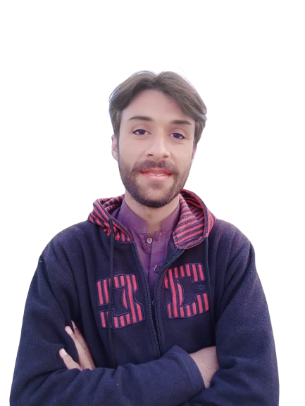
Complex Task Series
Problem Number 14

Slide 2
Problem Statement
Create a web application in python to display website different web page like home, contact us, about us etc

Slide 3
Algorithm
Step1: Install Python Django Library
Step2: Create Project
Step3: Create Application And Include In Settings.Py File In Django Project
Step4: Create Template Directory In Application
Step5: Create Home HTML File In Application Template
Step6: Create Contact us HTML File In Application Template
Step7: Create About us HTML File In Application Template
Step8: Write views for each template in views.py
Step9: Write URL for each views in urls.py
Step10: Display the result in browser
END

Slide 4
Assignment
Write A Python Program To Create Powerpoint File On User Request on Web

